Slide 1

External Project Presentation of Computer Networking(CSE 3034) on Topic [Multi-Thread Banking System]
Presented by)
Name-D JAI PRAKASH (Reg No-2141016312)
Name-SUBHASISH LENKA(Reg. N-2251012002)
Name-NITISH KUMAR SHAW(Reg. No-2141019290)
Supervisor
MR JAGDISH CHANDRA PADHI
Department of Computer Science Engineering
Institute of Technical Education & Research (ITER)
Siksha ‘O’ Anusandhan Deemed to be University, Bhubaneswar
Jan, 2024

Slide 2
Contents
Introduction
Problem statement
Methodology
Implementation
Result and Interpretation
Conclusion

Slide 3
Introduction
The project's core features include robust account management functionalities, enabling users to create, access, and manage their accounts seamlessly.
Essential banking operations such as deposits, withdrawals, and balance checks are implemented, and the system employs advanced synchronization mechanisms, specifically utilizing ReentrantLocks, to ensure thread safety.
To enhance auditability and tracking, every transaction is logged with a timestamp, providing a comprehensive record of user activities within the system.

Slide 4
Problem Statement
The problem at hand involves creating a console-based application where users interact by entering specific elements or objects. The primary objective is to design a system that allows users to input data through the console, and subsequently, reflects the results in either a file or a database. For instance, in the context of the multi-threaded banking system, users might be prompted to input account details, transaction types, and amounts through the console. The application then processes these inputs, performs the necessary operations on user accounts, and reflects the outcomes in the form of updated file content or database records. Several constraints need to be considered in the development of this console-based system:
1. Input Validation: The system must robustly validate user inputs to prevent errors and ensure the integrity of the data being entered.
2. Concurrency Control: Given the multi-threaded nature of the application, effective synchronization mechanisms, such as locks, must be in place to manage concurrent user interactions without compromising data consistency.
3. Security: The system should incorporate security measures to safeguard sensitive user information and prevent unauthorized access.
4. Error Handling: Adequate error handling mechanisms must be implemented to gracefully manage unexpected scenarios, providing users with informative feedback in case of input errors or system failures.
5. Database/File Management: Depending on the chosen storage method (file or database), efficient data management and storage strategies should be implemented to ensure the accuracy and accessibility of information

Slide 5
Methodology
To address the multi-threaded banking system problem, a clear algorithmic approach can be outlined to guide the development of the console-based application. The following pseudocode provides a high-level overview of the key steps involved:
1. Initialize the banking system with necessary data structures and synchronization locks.
2. Create a thread-safe mechanism for user input through the console.
3. Implement input validation procedures to ensure the accuracy and integrity of user entries.
4. Design concurrent processing methods for handling user transactions, utilizing synchronization mechanisms to prevent data inconsistencies.
5. Define functions for updating account information based on user inputs, incorporating secure practices to protect sensitive data.

Slide 6
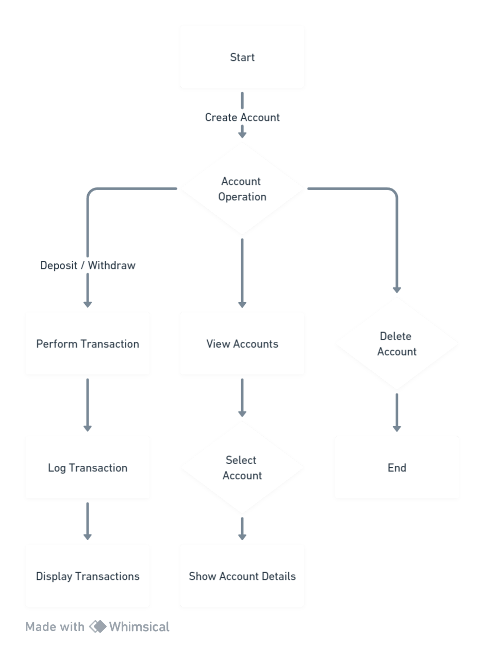
Implementation

Slide 7
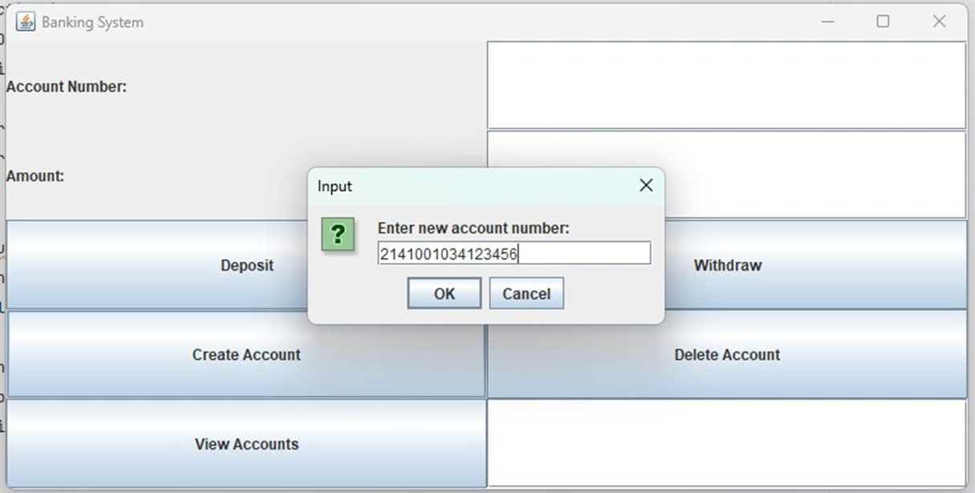
Result and Interpretation

Slide 8
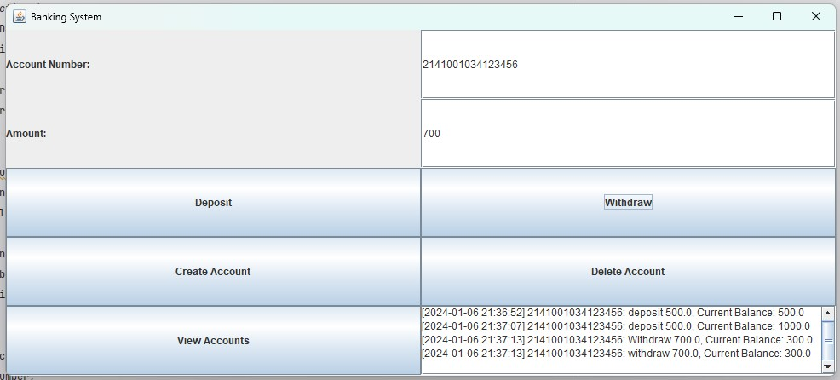
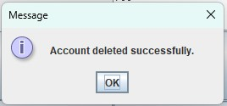
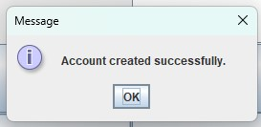
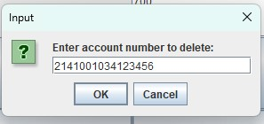
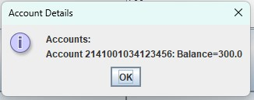

Slide 9
Conclusion
In conclusion, the Java code developed for this project has yielded a multi-threaded banking system featuring a graphical user interface (GUI). This system adeptly manages fundamental banking operations, including account creation, deletion, and transaction logging.
Noteworthy is the incorporation of synchronization mechanisms, specifically ReentrantLocks, ensuring the thread safety of critical sections during concurrent transactions
In summary, the current implementation serves as a commendable foundation for a multithreaded banking system with a GUI, poised for further refinement and expansion to meet evolving project specifications.

Slide 10
References
(As per the IEEE recommendations)
[1] Computer Networks, Andrew S. Tannenbaum, Pearson India.
[2] Java Network Programming by Harold, O’Reilly (Shroff Publishers).
[3] Oracle Corporation, "Java Platform, Standard Edition Documentation," Oracle, [Online]. Available: https://docs.oracle.com/en/java/javase/index.html
[4] Oracle Corporation, "Swing (Java)," Oracle, [Online]. Available: https://docs.oracle.com/javase/tutorial/uiswing/index.html
[5] Eckel, B. (2006). "Thinking in Java." Prentice Hall.
[6] Goetz, B., Peierls, T., Bloch, J., Bowbeer, J., Holmes, D., & Lea, D. (2006). "Java Concurrency in Practice." Addison-Wesley.

Slide 11


Slide 12


